Slide 1

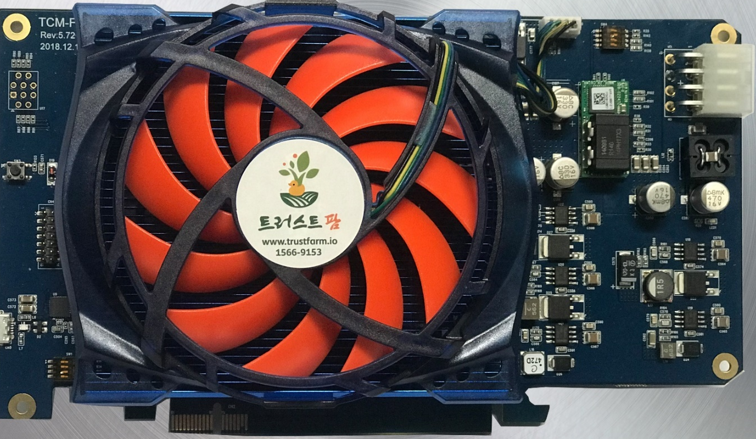
TrustCoinMining.com TCM-FM2L
Contact : info@trustfarm.net
Twitter : https://twitter.com/trustfarm
Toll-Free Call : 1566-9153

Slide 2
TCMFM2L ?
It is a special purpose device for AI and Mining.
It has superior powerful performance more so than a VGA card.
Adapted Xilinx High-End XCK7 FPGA chipset is used for the best possible performances for AI / MINING.
Very Low Power-Consumption -- But Very High Performances.
Product | Running Clock | Hash Power (Keccak Algo) | Power Consumption (PC ATX Power, Wall Consent)
TCM-FM2L | 500Mhz | 2.5 Ghash | 70~75W , Card Itself: 60~70W
Nvidia 1080Ti | 1580Mhz | 1.2 Ghash | 180~210W
AMD Rx 580 | 1250Mhz | 350 Mhash | 150~180W
The TCM-FM2L allows Algorithm Updates Anytime. We are also providing algorithms by us and by 3rd Party developers.
- ASIC Miners cannot change algorithms. This causes the miner to be worthless over time but, TCM-FM2L can change algorithms allowing the consumer to keep mining profitably for longer amounts of time.
- Algorithms currently in development: Groestl based algorithms, Monero, etc…

Slide 3
Save on Electric Fee by our Low Power Design.
- TCM-FM2L Power Consumption : 70~75W ( 0.11$ / 1KWh – 5.5$ / Month)
- Nvidia 1080TI Power Consumption : 200~250W ( 0.11$ / 1KWh – 16$ / Month)
1/3 Power Consumption, Double Profit: You Never lose your investment.
Used FPGA Miner will not be any cheaper.
- In this season the (mining profit recession), is 1/10th price when mining with GPU.
- We use Xilinx a High-End FPGA chipset used on TCM-FM2L to allow higher performances, it can be used for AI / Deep Learning Acceleration purposes, and for Educational Purposes.
- Trustfarm is developing the AI/Deep learning Cloud Service using FPGA Card, Similar to Amazon AWS, and Microsoft Azure.

Slide 4
Supported Algorithm and Coins
Development Status | Algorithm | Hash Power (estimated) | Coin Name
Released | Keccak | 2.5 Ghash | MaxCoin, CreativeCoin, SmartCash
Released | Keccak-Zp | 2.5 Ghash | ZenProtocol
Developing | 0xToken | 2.5 ~ 3Gh (estimated) | 0xBitcoin
Developing | dmd-groestl | 300Mh (estimated) | MBC (microBitcoin) , DMD(diamond)
Developing | groestl | 500Mh (estimated) | GroestlCoin
Developing | Skunk | - | HDAC, MUN, Vapecoin
Starting Development | MoneroV8 | - | Monero, Graft, Lethean, Wownero

